Slide 1
CS3907-80/CS6444-10: Big Data and Analytics Summer 2021 Stephen H. Kaisler, D.Sc.
Lecture 8 – Advanced Analytics

Slide 2
What is Advanced Analytics?
Advanced analytics:
the application of multiple analytic methods that address the diversity of big data – structured or unstructured
to provide descriptive results and
to yield actionable predictive and prescriptive results that facilitate decision-making.
Beyond data mining and statistical processing methods to encompass logic-based methods, qualitative analytics, and non-statistical quantitative methods.
A diverse set of techniques that require new software architectures and application frameworks to solve complex problems.
New metrics that focus on the contributions of the value of the analysis as a holistic result are required to assess and evaluate the outcomes of advanced analytics.

Slide 3
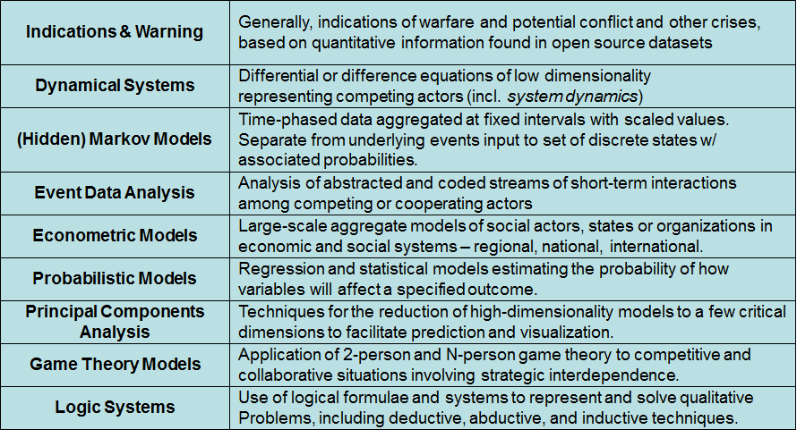
Analytics Classes - I
Ref: Kaisler & Cioffi-Revilla 2007, Kaisler 2012

Slide 4
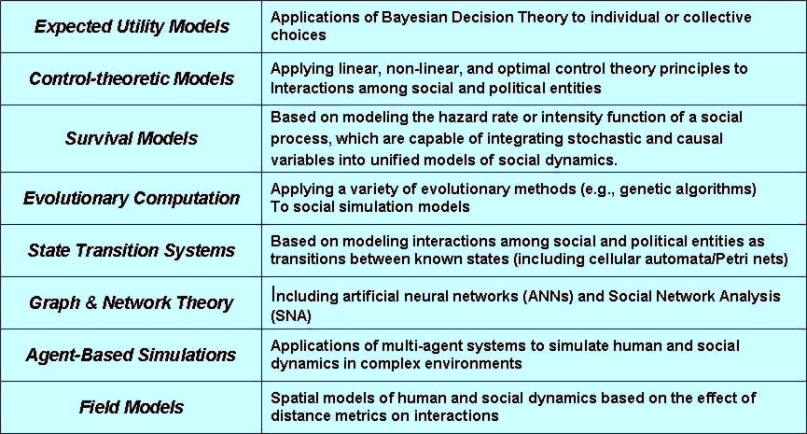
Analytics Classes - II
Ref: Kaisler & Cioffi-Revilla 2007, Kaisler 2012

Slide 5
What is Q/CSS?
Quantitative/Computational Social Science (CSS) is about:
developing integrated models of human, technical, and environmental systems
based on accepted principles in the social sciences (e.g., economics, anthropology, geography, political science, sociology, demography, ethnography, public policy, psychology, and their sub- and cross-disciplines, etc.)
supported by mathematical and physical science principles
investigates and experiments in situations where direct observations of human behavior are not possible or not ethical
develops new theory and insights that can be applied from the artificial to the natural world
?

Slide 6
Why Is Q/CSS Important Now?
Information and Risk are perennial issues with decision makers:
Without information, we cannot make rational decisions
Information about the future is usually imperfect and subject to uncertainty
Risk is inherent in any decision process:
Determine how much risk at what cost using what resources
Regarding gambling and insurance, where there is an expectation of loss, Arrow (1971) has said:
“Gambling is exemplified by preferring the small probability of a large gain and the large probability of a small loss to the certainty of an income greater than the mathematical expectation of the gamble; insurance means preferring a certain small loss to the small chance of a large loss”
People still make decisions about risky situations
Q/CSS models can assist in making such decisions,
by shedding new light on uncertainty.
Notes:
Edited heading ; added connection to Q/CSS in last point

Slide 7
Thus, we observe …
“God chose to give all the easy problems to the physicists.”
—Michael Lave & Jim March, Introduction to Models in the Social Sciences

Slide 8
What’s The Problem?
Most pre-computational social science models are linear:
Linearity is based on independence of elements
Is a good modeling technique for simple systems
The linearity assumption implies that the whole is equal to the sum of its parts!
We know a lot about:
Individuals (through surveys)
Aggregated as groups and populations
On a domain-specific basis
We know a lot less about interactions among individuals and groups:
How social structures form; how protocols emerge, and the interactions in large groups and among subgroups
How and why do group structures (and their protocols) change
What the content of interaction is: influence, power, imitation, exchange, association
BUT:
Social science systems are not simple,….
The whole may be greater (or lesser) than the sum of its parts!!
Modeling the dynamics is (very) hard …

Slide 9
Q/CSS Challenges
Are Computational Models Predictive Under Uncertainty?
In scientific computing, simulation credibility requires:
The fidelity of a model’s predictions to empirical data (verification)
The degree to which the model is robust under uncertainty
The accuracy of the model in predicting phenomena in regions where experiments haven’t been conducted
Main tradeoffs:
High fidelity models may be less robust to uncertainty
Models more robust under uncertainty may be less
consistent in their predictions

Slide 10
Q/CSS Challenges
Q/CSS is still an emerging discipline, but one that is mature in some areas
Most systematic studies of human behavior that follow the scientific model of research have analyzed numbers:
But, most human knowledge is represented in natural language in textual form
How to extract the relevant data in order to utilize it?
How to encode it without loss of precision or information?
Are numerically-based simulations the best way of studying human behavior and interactions in different social milieu.
Notes:
Added two points

Slide 11
Social Interaction
At the core of every interaction is both arbitrage and negotiation
Interactions between members of a well-defined social group turn on how each is engaged in looking after their economic and social investment
Must be able to measure and assess the quality of social interaction
Communication is also an essential feature of social interaction, mediated by signals (Shannon, Deutsch)
Reflexivity and self-consciousness is common in social interactions (and unknown in physical systems)
Challenges (after Schrodt 2000):
Multiple data sources for different perspectives
Temporal irregularity of the process (for example, diplomatic negotiations)
Varying complexity
Notes:
Added on communication and interaction.
Not sure about Schrodt (2000) here, since he was talking about events data, but let’s leave it.

Slide 12
Information Availability
Most information on human interactions – commerce, politics, religion, science, education – exists in one or more natural languages
Our challenge is to extract the relevant data from these sources
The number of items of qualitative and quantitative information available to an actor is, essentially, infinite.
But, the capacity of any entity (human, machine) to acquire and interpret that data is finite.
Limitations:
Multiple human natural languages; machine translation not yet as good as humans
Extracting and coding data for use in analysis programs
"Perfect" knowledge is never available; the news media cannot cover "everything" (Schrodt 2000)
Challenges:
Learning how to develop analysis systems that use other than numbers
How do we extract and exploit information from news sources in other than the English language?
How to measure and correct for bias and error in information coding?
How to represent multiple perspectives of the same events?

Slide 13

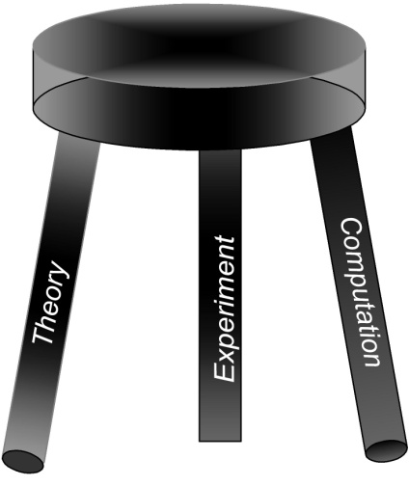
Complex Adaptive Systems
Complex, Adaptive Systems:
Exhibit behaviors arising from non-linear
spatio-temporal interactions among a
large number of components and
subsystems.
Proposition:
CAS studies indirect effects. Problems that are difficult to solve are often hard to understand because the causes and effects are not obviously related. Pushing on a complex system "here" often has effects "over there" because the parts are interdependent.
Takeaway:
CAS is a viable method for modeling complex physical and social systems to understand their behavior based on observed
data.

Slide 14
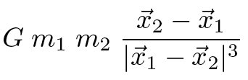
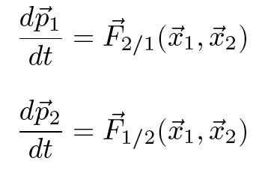
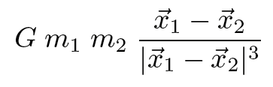
What is Complexity?
Complex: consisting of interconnected or interdependent parts
Not easy to understand or analyze
Simple systems: An oscillator, a pendulum, a spinning wheel, an orbiting planet
Complex Systems: Government, an economy, families, the human body—physiological perspective, a person—psychosocial perspective, the brain, the ecosystem of the world
Not Shannon, Turing, or Kolmogorov
non linear

Slide 15
Why Define Complexity?
To estimate how long a particular system will take to solve a problem
To estimate difficulty in engineering complex systems
To understand the limits of prediction, approximation, and simulation
To answer fundamental scientific questions
Does complexity increase through evolution – biological or otherwise?
“As evolution proceeded on the surface of the earth, there has been a progressive increase in size and complexity”
- J. T. Bonner Evolution of Complexity.
“Evolution tends to push systems towards the edge of chaos, where complex, interesting behaviors such as life can occur? “
- Chris Langton
“The universe, the biosphere, the econosphere have all become more complex”
- Stuart Kauffmann
Can we quantify the increase in complexity over time?

Slide 16
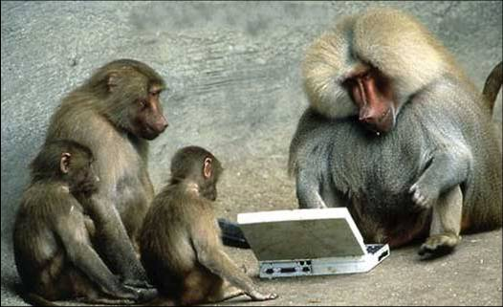
This is not Complexity!
One Thousand monkeys typing away are not going to recreate Shakespeare!

Slide 17
Complexity vs. Complicated
Complexity is difficult to describe
If we say something is complex in ‘everyday’ language we mean something that is difficult or impossible to understand with simple logic (i.e., long term weather patterns)
Complicated Systems: Often difficult to describe, but succumb to divide-and-conquer approaches.
A car is not complex, just complicated.
Cars do not exhibit “unwanted functionality”
Complicated is easier to cope with than complex – Seth Bullock
Numerous techniques to resolve complicated systems
As a last resort, use brute force/trial and error
But, complicated systems are often complex:
Software does suffer from “emergent” bugs!!

Slide 18
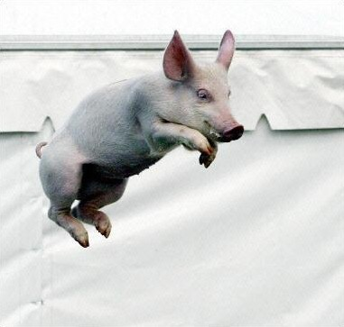
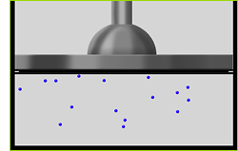
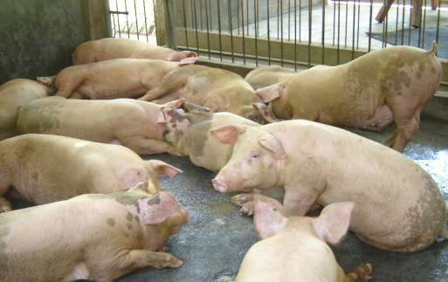
Explanation vs Prediction
Low-level behavior is unpredictable (gas molecules bouncing around, pigs pigging about)
We can explain how more gas increases temperature (ideal gas law) but not easy to explain how more pigs brings about an abrupt phase transition in pig violence
For simple (linear) systems:
a small change to a system’s components → a small change at the system level
For complex (non-linear) systems:
a small change to a system’s components → large/small/no change at the system level
From Seth Bullock, Introduction to Complexity Science, 2006
← Simple Gas
Complex Pigs →

Slide 19
Approaches To CAS
Considering complex adaptive systems, we are interested in:
how interactions give rise to patterns of behavior
understanding the ways of describing complex systems
how complex systems form through pattern formation and evolution
how complex systems adapt to their changing environment
How to measure a system’s complexity?
By its unpredictability?
By how difficult it is to describe?
No single model adequate to describe system---the more models that are required, the more complex the system. (Lee Segel)
By measuring how long before it halts, if ever? By how long until it repeats itself?
Entropy?
Multiple levels of organization?
Number of interdependencies?

Slide 20
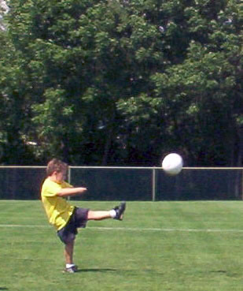
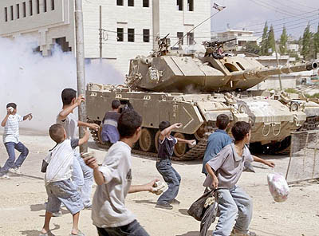
Why is the Study of CAS Important?
Problem of Computational Irreducibility:
The failure of mathematical models to provide explicit solutions to complex phenomena
Human behaviour is computationally irreducibile
Position and velocity can be calculated exactly

Slide 21
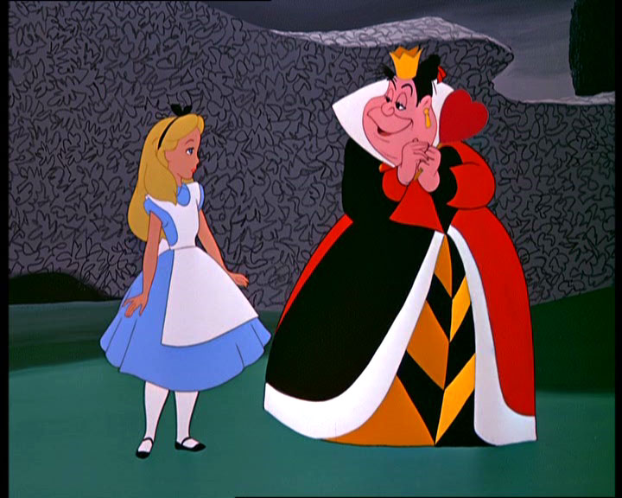
A little reflection …
Alice Laughed: “There’s no use trying,” she said; “one can’t believe impossible things.
“I daresay you haven’t had much practice,” said the Queen.
“When I was younger, I always did it for a half hour each day. Why, sometimes I’ve believed as many as six impossible things before breakfast.”
- Lewis Carroll, Alice in Wonderland -

Slide 22
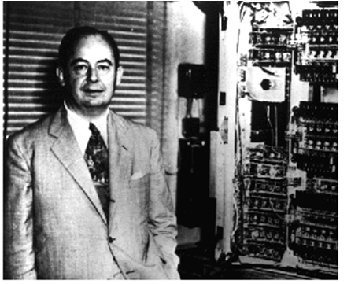
Cellular Automata
Originated with E. F. Codd and John von Neumann in 1950s
Popularized by John Conway’s Life Game, Scientific American, 1970
Basis for Stephen Wolfram’s book, A New Kind of Science. See M. Mitchell’s (2002) review.
Basic Structure:
A collection of fixed cells arrayed in a grid
A set of rules which are uniformly applied to the contents of each cell at each iteration of the automaton.
What Happens?
The structure of the cellular automaton evolves through a number of time steps based on the application of the rules and the contents of the cells and their neighbors.
John von Neumann

Slide 23
Conway’s Game of Life - I
An early example of 'emergent complexity' (1970)
Based on the rules chosen, one gets different objects with interesting properties
Implemented as a 2-dimensional cellular automata
Basic Ideas:
Life is played on a grid of square cells
A cell can be live or dead
A live cell is shown by putting a marker on its square
A dead cell is shown by leaving the square empty
Each cell in the grid has a neighborhood consisting of the eight cells in every direction including diagonals.
Rules:
An agent stays alive if 2 or 3 neighbors are alive, otherwise it dies.
New agent is born if exactly 3 neighbors are alive.

Slide 24









Conway's Game of Life - II
To apply one step of the rules, we count the number of live neighbors for each cell.
The number of live neighbors is always based on the cells before the rule was applied. In other words, we must first find all of the cells that change before changing any of them.
A dead cell with exactly three live neighbors becomes a live cell (birth)
A live cell with two or three live neighbors stays alive (survival)
In all other cases, a cell dies or remains dead (overcrowding or loneliness)

Slide 25
Conway's Game of Life - IIa
Examples of the rules
loneliness (dies if #alive =< 2)
overcrowding (dies if #alive >= 5)
procreation (lives if #alive = 3)

Slide 26





Conway's Game of Life - III
Still Life Objects: Very common in Life are groups of cells that remain constant through the many steps of life
Some types of still life objects are blocks, beehives, boats, ships, and loafs.
Block
Ship
Beehive
Loaf
Boat

Slide 27
Conway's Game of Life - IV
Oscillators-objects that change from step to step, but eventually repeat themselves.
May or may not change orientation as well
These include, but are not limited to, period 2 oscillators, including the blinker and the toad.
Blinker
Toad

Slide 28
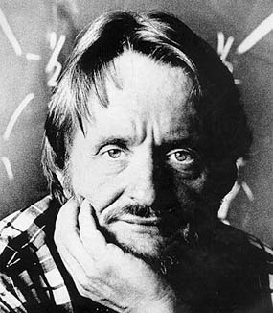
Conway’s Observation
Conway originally believed that no population could grow without limit.
Every population would either die out or repeat a pattern.
Students at MIT proved this incorrect.
They created a glider gun which would emit a glider every 30 generations and in turn create an endlessly growing life.
Questions:
Which forms of initial state persist as stable configurations?
Which recur periodically
Which die out? (equivalent to the halting problem)
Since early 1970’s hundreds of non-halting, reproducing or evolving automata have been demonstrated

Slide 29
John Conway – In Memoriam
John Conway died on April 11, 2020 of COVID-19 at the age of 82.
More than 50 years after Conway invented the Game of Life, it continues to have an active community of both professional mathematicians and amateurs.
Conway was an eminent mathematician who developed key ideas in Group Theory
But, with the Game of Life, he inspired millions to do play and do research in cellular automata.

Slide 30
Why Is Life Interesting?
Game of Life lets us experiment with systems where we don't know all the rules
Study simple systems to learn basic rules
Build on this knowledge to construct more complex systems
The rules are all that is needed to discover 'new' phenomena within the Life universe
Initial boundary conditions (e.g., the starting pattern(s)) lead to interesting phenomena, just as in the real world
Key Challenge!
At what point can systems such as Life be presumed to model the real world? In complexity? In fidelity?
Question: Can we adequately explain complex systems with sets of simple rules?
It's Fun To Play With!!
https://bitstorm.org/gameoflife/ is an on-line version you can try!

Slide 31
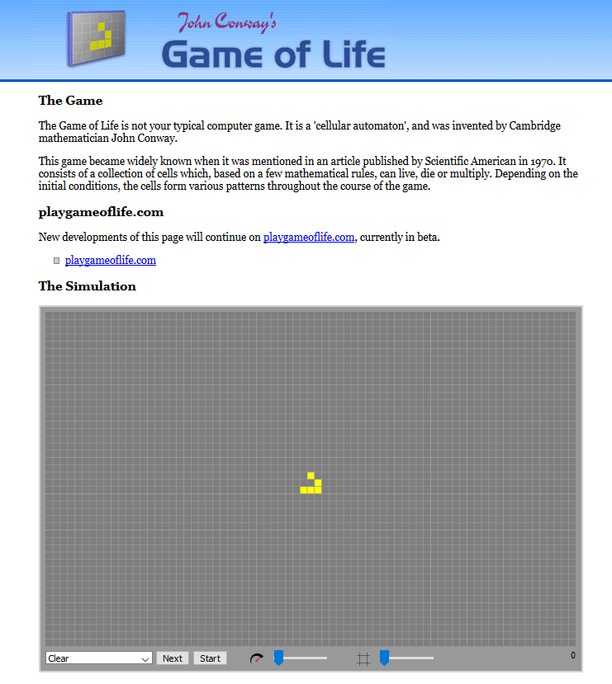

Slide 32
Applying CAs to Social Sciences - I
Why? Racial segregation has always been a pernicious social problem in the United States. Although much effort has been extended to desegregate our schools, churches, and neighborhoods, the US continues to remain segregated by race and economic lines.
In 1971, the American economist Thomas Schelling created an agent-based model that might help explain why segregation is so difficult to combat.
His model of segregation showed that even when individuals (or "agents") didn't mind being surrounded or living by agents of a different race, they would still choose to segregate themselves from other agents over time!
Although the model is quite simple, it gives a fascinating look at how individuals might self-segregate, even when they have no explicit desire to do so.

Slide 33
Applying CAs to Social Sciences - II
T. Schelling’s (1971) Segregation Model
Placed dimes and pennies on a chess board and moved them around according to various rules
Interpreted board as a city w/ each square representing a house or a lot
Pennies and dimes represented agents, e.g. two races
Neighborhood of an agent was the squares adjacent to the square in which the agent resided
Rules determined whether an agent was happy in its current location
If unhappy it could move to another location or exit the board entirely.
Results:
The board became segregated even if the agent’s “happiness Rules” did not favored segregation
The board became segregated if an initially integrated board had happiness rules that expressed a mild preference for neighbors of their own type

Slide 34
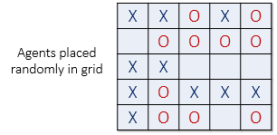
Applying CAs to Social Sciences - III
Suppose there are two types of agents: X and O. The two types of agents might represent different races, ethnicity, economic status, etc.
Two populations of the two agent types are initially placed into random locations of a neighborhood represented by a grid.
After placing all the agents in the grid, each cell is either occupied by an agent or is empty.
A satisfied agent is one that is surrounded by at least t percent of agents that are like itself.
Threshold t is one that will apply to all agents in the model, even though in reality everyone might have a different threshold they are satisfied with.
For example, if t = 30%, agent X is satisfied if at least 30% of its neighbors are also X. If fewer than 30% are X, then the agent is not satisfied, and it will want to change its location in the grid.

Slide 35
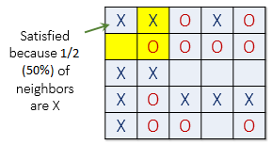
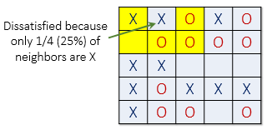
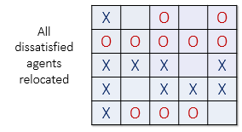
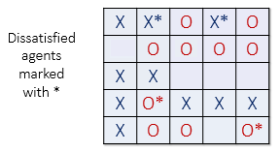
Applying CAs to Social Sciences - IV
Picture shows a satisfied agent because 50% of X's neighbors are also X (50% > t).
The next X (right) is not satisfied because only 25% of its neighbors are X (25% < t).
Notice that in this example empty cells are not counted when calculating similarity.
When an agent is not satisfied, it can be moved to any vacant location in the grid. Any algorithm can be used to choose this new location. For example, a randomly selected cell may be chosen, or the agent could move to the nearest available location.

Slide 36
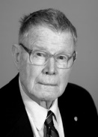
Applying CAs to Social Sciences - V
Received 2000 Nobel Prize in Economic Sciences for "having enhanced our understanding of conflict and cooperation through game-theory analysis".
Schelling offers an early model of “emergence” based on social/neighborhood interaction.
Weak local preferences yield strong global phenomena.
This model introduces novel explanations at both the “micro to macro” level and the “macro to micro” level:
macro regularities emerge from micro level interactions
macro regularities constrain individual agents and affect their behavior..
Download: http://www2.econ.iastate.edu/tesfatsi/demos/schelling/schellhp.htm
Game: Parable of the Polygons, https://ncase.me/polygons/

Slide 37
Recommended Readings
von Neumann, John. 1966. Theory of Self-Reproducing Automata. Urbana, Illinois: University of Illinois Press.
Schelling, Thomas C. 1971. Dynamic models of segregation. Journal of Mathematical Sociology 1:143-186.
Hegselmann, Rainer. 1996. Cellular automata in the social sciences: Perspectives, restrictions and artefacts. In Modeling and Simulation in the Social Sciences from the Philosophy of Science Perspective, edited by R. Hegselmann. Dordrecht, NL: Kluwer.
Cioffi-Revilla, Claudio, and Nicholas M. Gotts. 2003. Comparative analysis of agent-based social simulations: GeoSim and FEARLUS models. Journal of Artificial Societies and Social Systems 6 (4). Online.
Batty, Michael. 2006. Cities and Complexity: Understanding Cities with Cellular Automata, Agent-Based Models, and Fractals. Cambridge, MA: The MIT Press.
Mitchell, Melanie. 2002. “Is the universe a universal computer?” Science 298:65-68.

Slide 38
System Dynamics
Originated by Jay Forrester, MIT Sloan School of Management in the late 1950s
Popularized in Industrial Dynamics and Club of Rome’s Limits to Growth
Believed Operations Research (OR) neglected non-linear phenomena and relationships among functions
Focused on nonlinear interactions
A rigorous method for the qualitative description, exploration and analysis of complex systems in terms of their processes, information, organisational boundaries and strategies; which facilitates quantitative simulation modelling and analysis for the design of system structure and behaviour - Wolstenholme (1990)
Applies concepts of control engineering theory; feedback is the differentiator
Systems dynamics (SD) simulations consist of a set of lagged difference equations that are solved forward in time

Slide 39
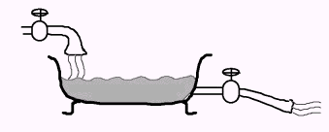
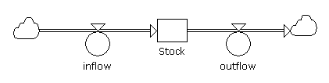
System Dynamics - II
Representing stocks and flows
Bath tub:
Stock and flow diagram:
Integral equation:
Differential equation:

Slide 40
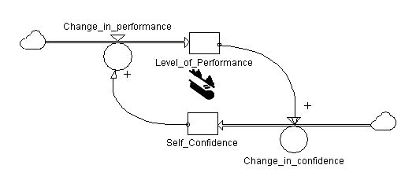
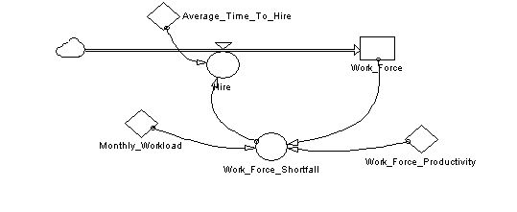
System Dynamics - III
Positive feedback behavior
0
Time
Negative feedback behavior
2
2
1
2
1
2
1
2
1
1
1
0
Time

Slide 41
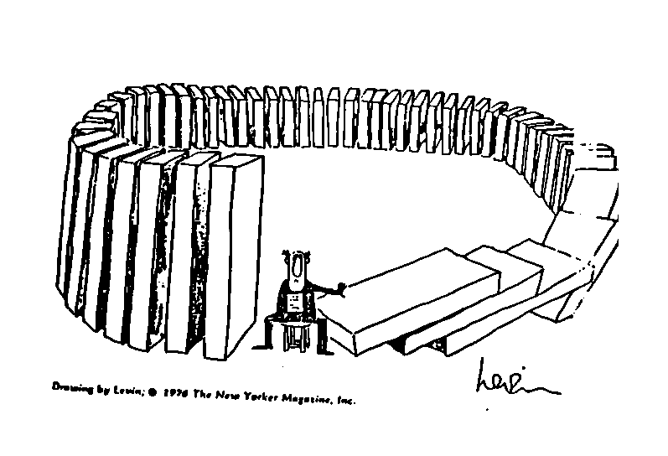

System Dynamics Modeling
Cause and Effect:
Identify a problem (Draw a picture!)
Develop a dynamic hypothesis explaining the cause of the problem
Create a basic structure of a causal graph
Augment the causal graph with more information
Feedback:
Focus on feedback linkages among components of the system
Where the action is! Closed, causal feedback loops
Boundaries:
Determining the appropriate boundaries for defining what is to be included within a system
Tools: DYNAMO, VENSIM
+
+
+

Slide 42
Causal Loops - I
Represent the feedback structure of systems
The hypotheses about the causes of dynamics
The important feedbacks
Signing: Add a ‘+’ or a ‘–’ sign at each arrowhead to convey more information
A ‘+’ is used if the cause increase, the effect increases and if the cause decrease, the effect decreases
A ‘-’ is used if the cause increases, the effect decreases and if the cause decreases, the effect increases
The more I sleep The less tired I am
The less tired I am
The less I sleep
The more tired I am
The more I sleep
The less I sleep The more tired I am
+
-
Negative Feedback Loop
-

Slide 43
Causal Loops - II
Positive feedback loops
Have an even number of ‘–’ signs
Some quantity increase, a “snowball” effect takes over and that quantity continues to increase
The “snowball” effect can also work in reverse
Generate behaviors of growth, amplify, deviation, and reinforce
Notation: place symbol in the center of the loop
Negative feedback loops
Have an odd number of “–” signs
Tend to produce “stable”, “balance”, “equilibrium” and “goal-seeking” behavior over time
Notation: place symbol in the center of the loop
The more salary I get
The better I perform
The better I perform
The more salary I get
+
The more salary I get
The better I perform
Positive
Feedback
Loop
+
+
-
+

Slide 44
Loop Dominance
There are many systems which have more than one feedback loop within them
A particular loop in a system w/ multiple loops is most responsible for the overall behavior of that system
The dominating loop might shift over time
When a feedback loop is within another, one loop must dominate
Stable conditions will exist when negative loops dominate positive loops
+
+
+
-
+
-

Slide 45
Exogenous Variables
Items that affect other items in the system but are not themselves affected by anything in the system
Arrows are drawn from these items but there are no arrows drawn to these items
+
-
-
+

Slide 46
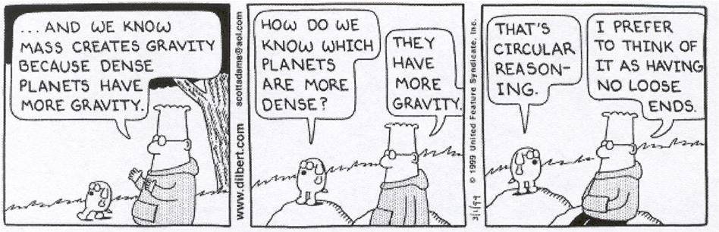
System Dynamics
Cause and Effect in One Easy Step:

Slide 47
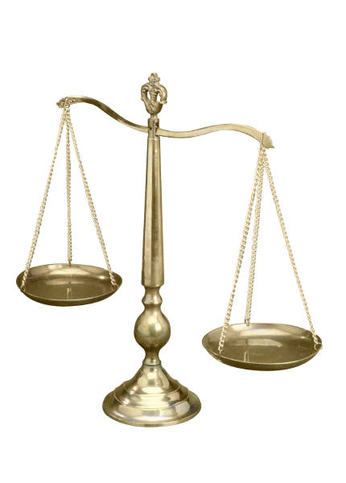
State Stability
The stability of the state is a function of the relationship between the loads (or pressures) on the system, and its capacities (or power) to manage these loads.
Loads Capacities
Insurgents
Dissidents
Protests
Violent Incidents
Negative Messages
Regime Legitimacy
Economic Performance
Social Capacity
Political Capacity

Slide 48
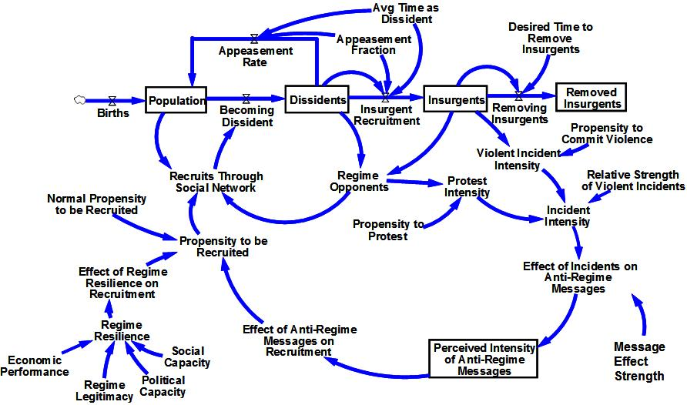
Dissident and Insurgent Escalation - I
Choucri, Morrison,
Siegel, Madnick

Slide 49
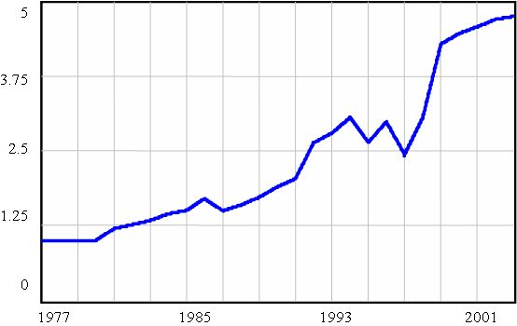
Dissident and Insurgent Escalation - II
Capacities
Regime Legitimacy (Polity Index
- Open and free election (1998)
Economic Performance (GDP/civilian employment per capita)
- Steady growth1980-90
Social Capacity (Literacy
- Steady growth since 1980
Political Capacity (Civil liberties)
Nazli Choucri, Brad Morrison, Michael Siegel, Stu Madnick
State Stability: Exploiting System Dynamics
PCAS Final MPR

Slide 50
Dissident and Insurgent Escalation - III
Dissidents and insurgents create loads on the state
Dissidents and insurgents draw in people from all parts
Protests and violence undermine regime support
Such acts shift power balances
Anti-regime messages circulate throughout the society
Reducing support for the regime (and therefore the capacity of the regime)
Messages feed back and create new ‘loads’ as recruit strength for dissidents and insurgents grows
State stability depends on dynamic interactions of insurgence (load) and regime resilience (capacity)

Slide 51
Dissident and Insurgent Escalation - IV
Regime
Resilience
Capacities Loads
Insurgents
6
20,000
16,250
3
12,500
8,750
Resilience Drops
0
5,000
1980
1990
2000
2010
2005
2006
2007
2008
2009
2010
Time (Year)
Time (Year)
Economic Performance
oil shock
Political Capacity
judicial breakdown
Regime Legitimacy
election fraud
Social Capacity
healthcare failure
The dynamic system of insurgent growth has a tipping point

Slide 52
Dissident and Insurgent Escalation - V
Removing insurgents has a limited effect Preventing recruitment effects a sustained reduction
Tipping
Point
Insurgents
27,000
25,250
23,500
21,750
Better insurgent removal
Preventing recruitment
20,000
2005
2006
2007
2008
2009
2010
Time (Year)
Better insurgent removal
intelligence sharing
Preventing recruitment
moderate rhetoric

Slide 53
System Dynamics: Assessment
An aggregate, macro-level approach for modeling a system
SD models have a fixed dynamic structure – not able to reproduce the process of moving from one structure to another
SD models typically include “soft” variables that are difficult to translate into numerical values
Significant potential for asking what-if questions, test alternative policies
Visualization is a plus, but can be complicated with many components
Continuous computational support from DYNAMO, to STELLA, to VENSIM

Slide 54
Game-Theory Analysis

Slide 55
Game Theory
Game Theory: agents make decisions based not on reactions to exogeneous events, but as strategic reactions to other agent’s actions.
Generally used in Economics and Political Science:
The rules of the game state who can do what, and when they can do it.
A player's strategy is a plan for actions in each possible situation in the game.
“I can calculate the motions of heavenly bodies, but not the madness of people”
- Isaac Newton, upon losing £20,000 in the South Sea Bubble in 1720

Slide 56
Game Theory II
Rationality Assumption:
All players are assumed rational
All players know that all other players are rational.
Definition: rationality means that actors are goal-oriented and calculating.
Each player in a game tries to achieve the highest possible payoff for himself (at the expense of the other players).
Each player’s well-being depends on the decisions of others as well as her own.
Each player calculates a strategy that best serves these interests.
Each player assesses the value of alternative courses of action and compares them before determining which course to take.
Rationality does not mean:
Selfish
Short-run
Sharing the same value system as other players or “ethical people”

Slide 57
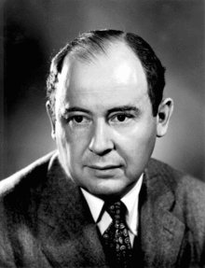
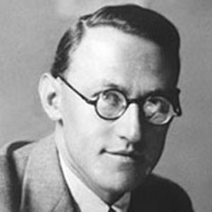
Game Theory
Originated with John von Neumann and Oskar Morgenstern in the 1940s
Models "zero-sum games”
Generally, 2-person games
von Neumann, John, and Oskar Morgenstern. Theory of Games and Economic Behavior. Second edition. Princeton, New Jersey: Princeton University Press, 1947
Assesses the cost versus the benefits of behaviors in interdependent decision-making situations among two or more actors
Examples: tic-tac-toe, checkers, chess, marriage (?), tennis

Slide 58

Game Theory vs. Decision Models
Game Theory (GT) focuses on how actors decide when outcomes are interdependent
Cooperative GT: actors make decisions by accounting for actions/reactions of other actors in context
Noncooperative GT: deals largely with how intelligent individuals interact with one another in an effort to achieve their own goals.
Decision Theory: Earlier (B. Pascal, D. Bernoulli, T. Bayes) formal model of a single player deciding against Nature
Basic version: preferences among risky alternatives can be described by maximizing the expected value of a numerical utility function.

Slide 59
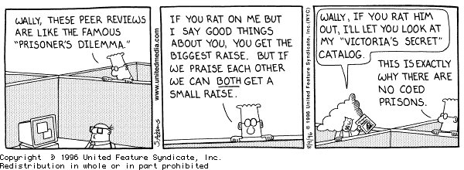
Why Study Game Theory?
All “intelligent” beings make decisions all the time.
Learn to analyze situations more rationally and to formulate an acceptable alternative with respect to circumstances.
Useful in modeling strategic decision-making:
Games against opponents
Games against "nature“
Provides structured insight into the value of information
Provides insight into decision processes
Find acceptable, if not optimal, strategies in conflict/competitive situations

Slide 60
The Great Game
Before Game Theory, but a sterling example of it!
A political and diplomatic confrontation that existed for most of the nineteenth century between the British Empire and the Russian Empire over Afghanistan and neighbouring territories in Central and Southern Asia.
Russia was fearful of British commercial and military inroads into Central Asia.
Britain was fearful of Russia adding "the jewel in the crown", India, to the vast empire that Russia was building in Asia.
An atmosphere of distrust and the constant threat of war between the two empires developed and continually evolved as each government made political, economic and military moves
Included at least four wars in the region.
Resolved after Russian Annexation of certain territories with the Pamir Agreement to set boundaries.
Modern Day: The Game of Risk
Read the 1901 novel Kim by Rudyard Kipling
A fictional account that misses reality, but a good read.
See The Flashman novels by George McDonald Fraser

Slide 61
2-Person Game Theory
2-person game theory is considered complete; n-person game theory is incomplete
.
Type of Interaction
A
B
Nature of Interaction
Competition
-
-
Each actor inhibits the other
Predation/Parasitism
+
-
A exploits B
Cooperation
+
+
Interaction is favorable to both
Commensalism
+
0
A benefits, but B is not affected
Amensalism
-
0
A is inhibited, but B is not affected
Neutralism
0
0
Neither A or B is affected
Birds on water buffalo backs, or picking crocodile teeth

Slide 62
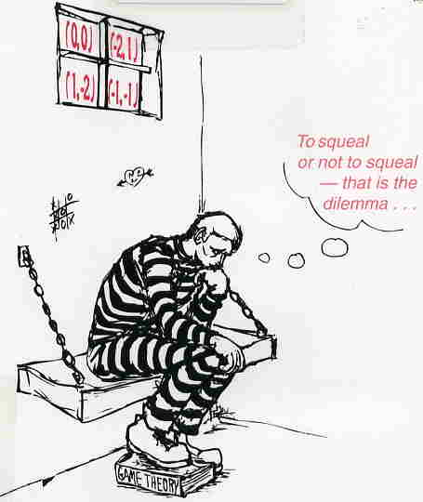

The Prisoner’s Dilemma
A classic game theory model formulated by Flood, Dresher, and Tucker (1905-1995).
Recommended: Poundstone (1992), Prisoners’ Dilemma.
Two known criminals are captured by the police.
Each suspect is placed in a separate cell, and offered the opportunity to confess to the crime.
Each prisoner chooses one of the two strategies.
The two numbers in each cell tell the outcomes for the two prisoners when the corresponding pair of strategies is chosen.
The game can be represented by the following matrix of payoffs (Tucker)

Slide 63
The Prisoner’s Dilemma
If neither suspect confesses (I.e., they cooperate between them):
they both go free, and split the proceeds of their crime which we represent by 5 units of utility for each suspect.
However, if one prisoner confesses (Defects D) and the other does not
the prisoner who confesses testifies against the other in exchange for going free and gets the entire 10 units of utility
while the prisoner who did not confess, goes to prison and gets nothing.
If both prisoners confess (DD, mutual defection)
then both are given a reduced term, but both are convicted, which we represent by giving each 1 unit of utility:
better than having the other prisoner confess, but not so good as going free.
In fact, numerous studies have shown that this is the best “outcome” for both agents and is thus the “solution” to the game.

Slide 64
The Prisoner’s Dilemma: Challenges
Remember: A game is defined by the rules (e.g., finite or not) and rank-ordering of preferences
Rules OR preferences change ➔ the game changes
A simple representation of a plethora of important problems throughout social science
Think of it as a mathematical function f(x,y) which returns multiple values.
The game could be played between larger sets of players, but by Curry’s theorem, any n-argument function can be reduced to a set of functions of two arguments.
It is (supposedly) self-evident how the intelligent individual should behave.
Game changes if it is repeated in the future (with past history known) or if the players interact with each other.
Empirical estimation difficult but sometimes feasible

Slide 65
Representation: Normal Form - I
Column Player
left right
Row up 10, 20 15, 8
Player down -10, 7 10, 10
The “row” player’s options are described in each row and the payoff is the first number in each cell.
The “column” player’s options are described in each column and the payoff is the second number in each cell.
Assume the row player picks up and the column player picks left
If the game ended at up, left, the row player would get “10” and the column player would get “20”
If the game ended at down, right, the row player would get
“10” and the column player would get “10”

Slide 66
Representation: Normal Form - II
Row Player Strategy:
I do not know what the column player will do. But, I can look at each option of the column player, one strategy at a time.
If the column player picks left my choices are: up 10, down -10
I would pick the option that has the highest value: pick up if 10 > -10, or pick down if 10 < -10.
If the column player picks right my choices are: up 15 or down 10.
As the row player I would pick the option that has the highest value: pick up if 15 > 10, or pick down if 15 < 10.
A strategy is called a dominant strategy for a player if it has a higher payoff no matter what the other player chooses.
Up would be a dominant strategy for the row player if both 10 > -10 and 15 > 10.
Down would be a dominant strategy for the row player if
both 10 < -10 and 15 < 10.

Slide 67
Representation: Normal Form - III
So, the results are:
Column Player
left right
Row up 10, 20 15, 8
Player down -10, 7 10, 10
A Nash Equilibrium exists if neither player would want to change their
choices given the choice made by the other player.

Slide 68
Representation: Normal Form - IV
Dominant Strategy: Let an individual player in a game evaluate separately each of the strategy combinations he may face:
For each combination, choose from his own strategies the one that gives the best payoff.
If the same strategy is chosen for each of the different combinations of strategies the player might face, that strategy is called a "dominant strategy" for that player in that game.
Dominant Strategy Equilibrium: If, in a game, each player has a dominant strategy, and each player plays the dominant strategy, then that combination of (dominant) strategies and the corresponding payoffs are said to constitute the dominant strategy equilibrium for that game.
In the Prisoners' Dilemma game, to confess is a dominant strategy, and when both prisoners confess, that is a dominant strategy equilibrium.

Slide 69
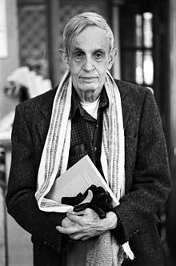
John Nash, Jr.
Sylvia Nasar’s A Beautiful Mind
A biography of John Nash
Made into a movie starring Russell Crowe (not historically accurate)
PhD Thesis (28 pages) on non-cooperative games
Received the Nobel Memorial Prize in Economic Sciences in 1994 for his work on the Nash Equilibrium
Conceived of the Nash Equilibrium sitting in a bar with friends contemplating a group of girls who they were thinking of asking out. If the prettiest one rejected them, all might reject them as fallbacks, so each should take into account the other’s decisions and each choose one to ask out.
Similar to a “divide and conquer” approach

Slide 70
N-person Game Theory: An Example
The Tragedy of the Commons (G. Hardin, L. Ostrom)
First observed in Britain, but considered a Cross-Cultural Universal
Describes the problem of the unregulated use of a public good
Assume a “public good”, e.g. a common pasture for grazing of cattle in a village
Assume a village with 10 families
Each family has 10 cows which just exactly provide the food they need.
The village commons has a carrying capacity of 100 cows
Each cow produces 500 lbs. of meat & dairy per year up to or at carrying capacity of the pasture.
10 families X 10 Cows X 500 lbs. = 50,000 lbs. of food at carrying capacity

Slide 71
N-person Game Theory: An Example
…and then Farmer Smythe’s wife has triplets…
So Farmer Smythe decides he really needs one more cow.
And there is no one to tell him no because the commons is an unregulated public good
Like Air, Water, Security, NPR
With the overgrazing, each cow will now produce only 490 lbs. of food.
10 families X 10 Cows X 490 lbs. = 49,000 lbs. of food at carrying capacity
Each family gets 4900 lbs. of meat & dairy, instead of 5000.
Except Farmer Smythe, who gets 5390 lbs.
Even with the reduced carrying capacity, it is still to his advantage to add the extra cow, to the detriment of his neighbors.

Slide 72
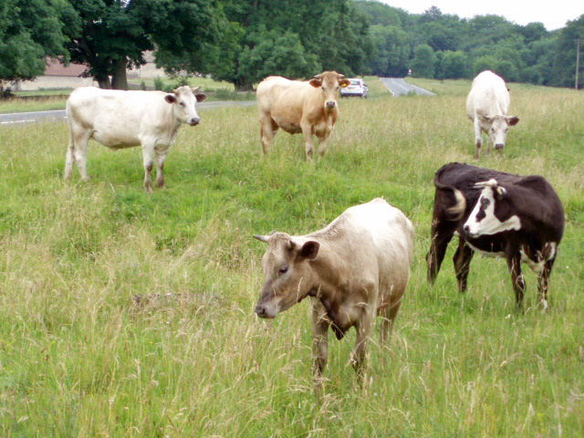
Hardin and Ostrom’s Premise
“Picture a pasture that is open to all. Each herdsman will try to keep as many cattle as possible on the commons…the inherent logic of the commons remorselessly generates tragedy.” ---Garrett Hardin, The Tragedy of the Commons 1968
Local Commons:
Pastures
Woodlands
Fishing grounds
Hunting Grounds
Watersheds
Ground Water Basins
Oil Fields
Parking spaces

Slide 73
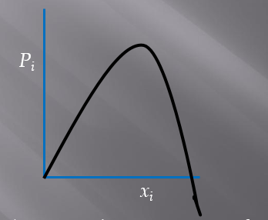
An Appropriation Game
Common resource is shared by N players, intensity of use by i is x_{i}.
number of cows pastured, amount of water extracted, etc.
Payoff to player i is P_{i}(x_{i},Σx_{j}).
Given actions of others, P_{i}(x_{i},Σx_{j}) is increasing in x_{i} over some range and then decreasing.
P_{i}(x_{i},Σx_{j}) is a decreasing function of Σx

Slide 74
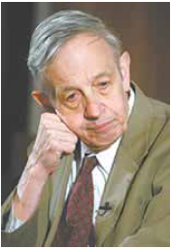
Nash Equilibrium - I
Occurs when each player's strategy is optimal, given the strategies of the other players:
A player's best response (or best strategy) is the strategy that maximizes that player's payoff, given the strategies of other players.
A Nash equilibrium is a situation in which each player makes his or her best response.
Example: Chess
Large (very, very large), but finite number of board positions
But, complete information about state is known and visible
Therefore, a Nash equilibrium exists!
Just completely infeasible to compute it!
But, Nash equilibrium analyzes once-only games,
e.g., play and forget
Problem: How to handle repeated games?
Consider Peter Bock’s Collective Learning Automata
See: Sylvia Nasar, A Beautiful Mind, biography of John Nash

Slide 75
Nash Equilibrium - II
A Nash equilibrium arises from the assumption that every agent makes rational choices.
It is a set of strategies, one per player, such that each player’s strategy is that player’s best strategy against the strategies chosen by the other players.
When there are no dominant strategies, the Nash Equilibrium suggest that each player pick the best strategy for himself.
If agents sometimes choose to do something irrational, then they destroy the conditions for a solution.
When multiple agents have different strategy sets, there may be no set of choices that leads to a unique solution.
Indeed, there may be many possible solutions that depend on the parameters of the game.
While many games possess a Nash equilibrium, not all do.
See: Sylvia Nasar, A Beautiful Mind, biography of John Nash

Slide 76
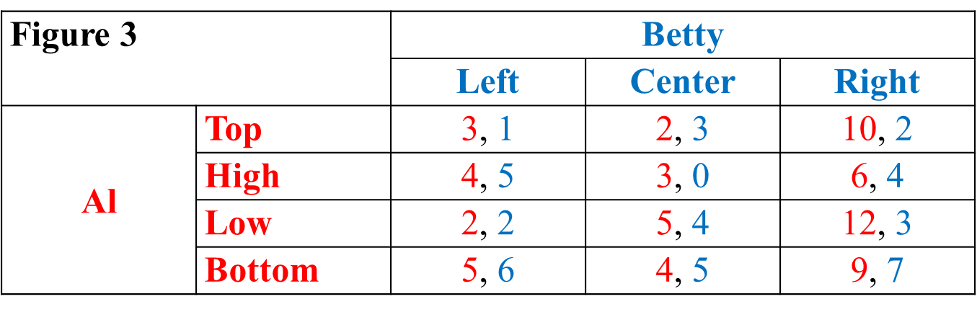
Nash Equilibrium - III
The Nash equilibrium is a set of strategies, one per player, such that each player’s strategy is that player’s best strategy against the strategies chosen by the other players.
Does it have a Nash Equilibrium?
What is it?

Slide 77
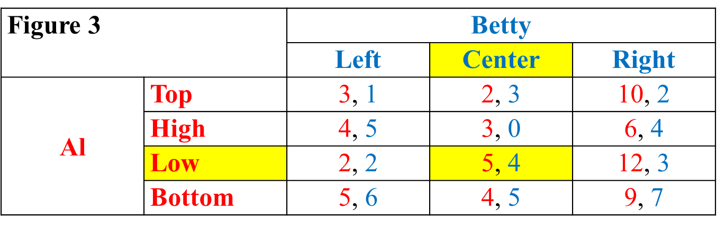
Nash Equilibrium - IV
Note first that this is not a zero-sum game.
For example, if Al plays Top and Betty plays Center, Al gets $2 and Betty gets $3.
These gains are mutual gains and are not obtained at each other’s expense.
Betty’s best strategy is Center and Al’s is Low

Slide 78
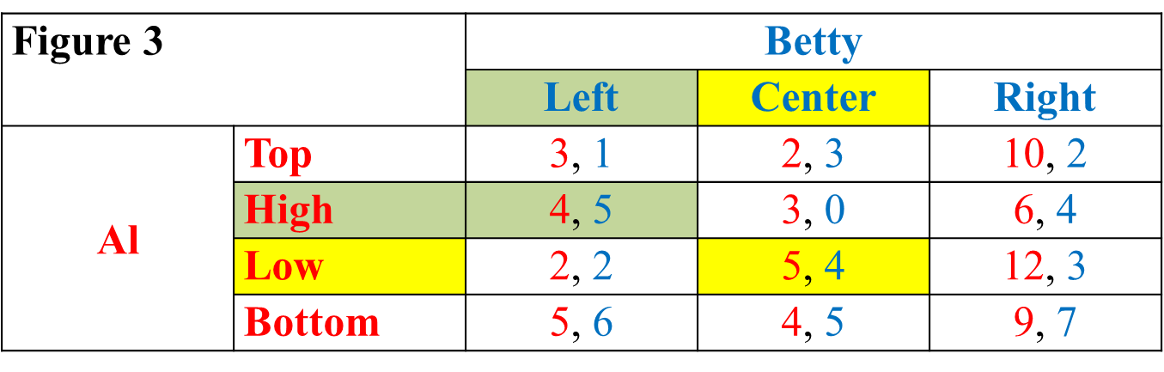
Nash Equilibrium - V
None of the other possible choices fit the definition of Nash equilibrium.
Convince yourself that this is true!
This is not a Nash equilibrium because, although Left is indeed Betty’s best move when Al plays High, Al’s best move when Betty plays Left is Bottom, not High.

Slide 79
Nash Equilibrium - VI
Nash was able to show that virtually any game-like situation that one could think of is guaranteed to have at least one Nash equilibrium.
In other words, for virtually any problem in the social sciences, the Nash equilibrium concept makes it possible to say something definite about the likely outcome; one does not have to throw up one’s hands in despair.

Slide 80
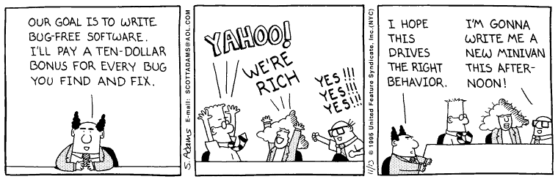
Finally, An Application of Game Theory!

Slide 81
Recommended Readings
Poundstone, William. 1992. Prisoner's Dilemma: John von Neumann, Game Theory, and the Puzzle of the Bomb. New York: Random House.
Rapoport, Anatol. 1970. N-Person Game Theory: Concepts and Applications, Ann Arbor Science Library. Ann Arbor, Michigan: Ann Arbor-The University of Michigan Press.
Rapoport, Anatol. 1973. Two-Person Game Theory: The Essential Ideas, Ann Arbor Science Paperbacks. Ann Arbor, Michigan: Ann Arbor-The University of Michigan Press.
Lichbach, Mark I. 1996. The Cooperator's Dilemma. Ann Arbor, MI: University of Michigan Press.
Ordeshook, Peter C. 1986. Game Theory and Political Theory. Cambridge, Mass.: Cambridge University Press.
Prisoner's Dilemma by Steven Kuhn, Stanford Encyclopedia of Philosophy
Evolutionary Game Theory by J. McKenzie Alexander, Stanford Encyclopedia of Philosophy
Game Theory by Don Ross, Stanford Encyclopedia of Philosophy

Slide 82
References
Kaisler, S. and C. Cioffi-Revilla. 2007. Quantitative and Computational Social Sciences Tutorial, 40th Hawaii International Conference on System Sciences, Waikoloa, HI, 2007
S. Kaisler, F. Armour, A. Espinosa, and W. Money. 2013. “Big Data: Issues and Challenges Moving Forward”, 46th Hawaii International Conference on System Sciences, Grand Wailea, Maui, HI
S. Kaisler, F. Armour, A. Espinosa, and W. Money. 2014. “Advanced Analytics: Issues and Challenges”, 47th Hawaii International Conference on System Sciences, Hilton Waikoloa, Big Island, HI
S. Kaisler, F. Armour, W. Money, and A. Espinosa. 2014. “Big Data: Issues and Challenges”, Encyclopedia of Science and Technology, 3rd Edition, IGI Global
S. Kaisler, F. Armour, A. Espinosa, and W. Money. 2014. “Advanced Analytics: Issues and Challenges”, Encyclopedia of Science and Technology, 3rd Edition, IGI Global

